Slide 1
Team Interrupt_zero1 (11D)
Names-
RAJAT KESHRI 3rd year ECE , R.V. College of Engineering
NISHANTH D A 3rd year ECE , R.V. College of Engineering
Problem Statement – No. 4 (D)
Related to Speech Domain

Slide 2
Problem statement 4
In speech domain, tagging and identifying speakers in conversation is of prime importance to tailor the product or solution offerings. Objective
The objective is to identify the exact timestamp wherein one speaker stops speaking and another speaker starts – which is known as turn indication. The 100 hours of data is available for training.
Expected Output
Software Algorithm, Model and Scripts that receives an audio stream (or reads a large audio file) and generates a log file with timestamp indicating the turn.

Slide 3

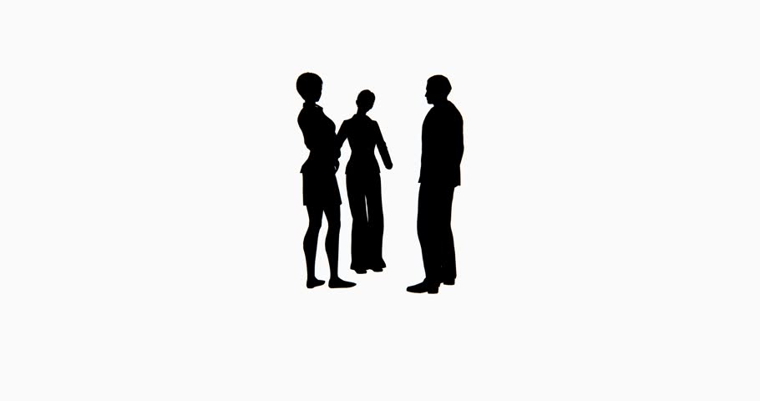
WHY SPEAKER DIARIZATION/SPEAKER CHANGING DETECTION?
NEWS PODCAST, CONFERENCE CALLS
AIR TRAFFIC CONTROL

Slide 4
HOW WE APPROACHED?
INPUT AUDIO FILE
BAYESIAN INFORMATION CRITERIA FUNCTION
ANALYSIS OF DATA
PREPROCESSING
K MEANS CLUSTERING
DATA VISUALISATION(GRAPHS)
CALCULATION OF MFCC
OUTPUT TIME STAMP
MAPPING FRAMES WITH SECONDS

Slide 5
HOW BAYESIAN INFORMATION CRITERA FUNCTION WORK
-22 324 34 32 5 -432 -21
A
. . . . . . . . . . . . . . . . . . . .
C
. . . . . . . . . . . . . . . . . . . .
MFCC FEATURE MATRIX
B
. . . . . . . . . . . . . . . . . . . .
. . . . . . . . . . . . . . . . . . . .
. . . . . . . . . . . . . . . . . . . .
Number of frames x features
IF (BIC(A)+BIC(B)-BIC(C)) == 0 ---> NO SPEAKER CHANGE
ELSE ---> SPEAKER CHANGE
SAVE THE FRAME VALUE IN LOG FIILE

Slide 6
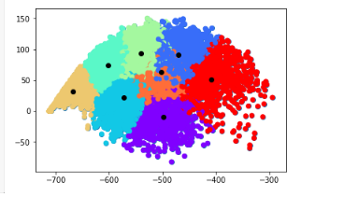
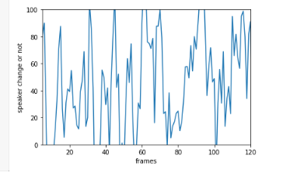
Some graphical outputs

Slide 7
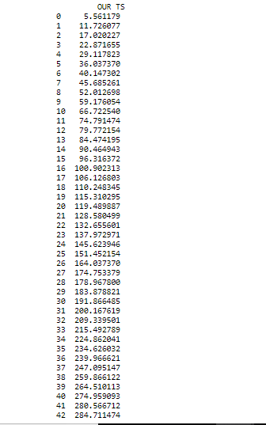
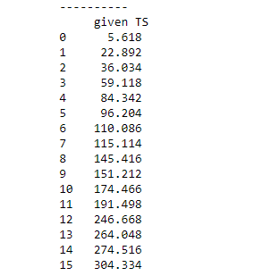
TIMESTAMP OUTPUT

Slide 8
DEMO!

Slide 9
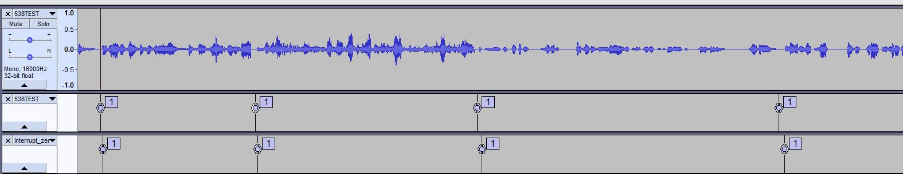
FINAL TEST CASE IN THE JUDGING ROUND
GRND Truth VS Snapshot
Our model predicted 43 times speaker change
Ground truth gave 41 times speaker change
The error rate found out is less than 100ms

Slide 10

EXPERIENCE!

Slide 11
FUTURE EXTENSIONS
SPEAKER RECOGNITION CAN BE ESTABLISHED USING HIDDEN MARKOV MODELS ALONG WITH THIS APPROACH
AND CAN ACTUALLY TELL WHETHER THE SAME SPEAKER HAS SPOKEN AGAIN OR NOT
SUBTITLES SYNCHRONIZATION
ATC, NEWS HOUR, PODCAST SPEAKER CHANGE DETECTION

Slide 12
Q/A?

Slide 13
References
[1] “Speaker Diarization based on Bayesian HMM with Eigenvoice Priors”, Mireia Diez, Lukáš Burget, Pavel Matˇejka
Brno University of Technology, Speech@FIT, Czechia
[2] “Spectral Clustering Approach to Speaker Diarization”, Huazhong Ning, Ming Liu, Hao Tang, Thomas Huang,Beckman Institute, U. of Illinois at Urbana-Champaign

